Slide 1
SmartFind project evaluation
NLP-based

Slide 2
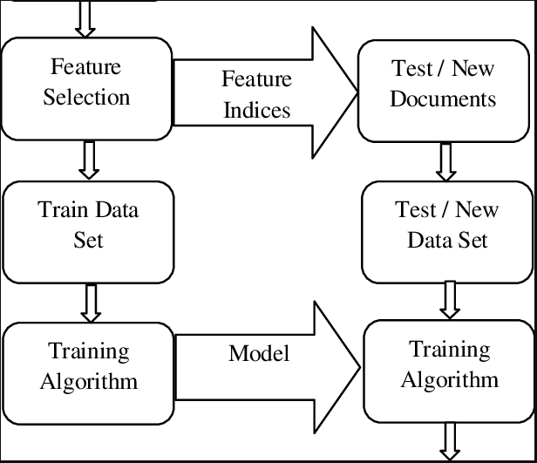
Workflows

Slide 3
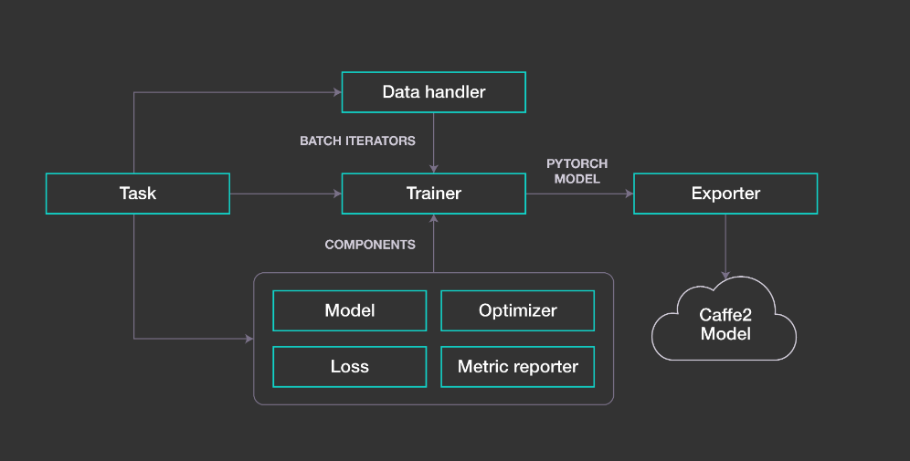
Architecture

Slide 4
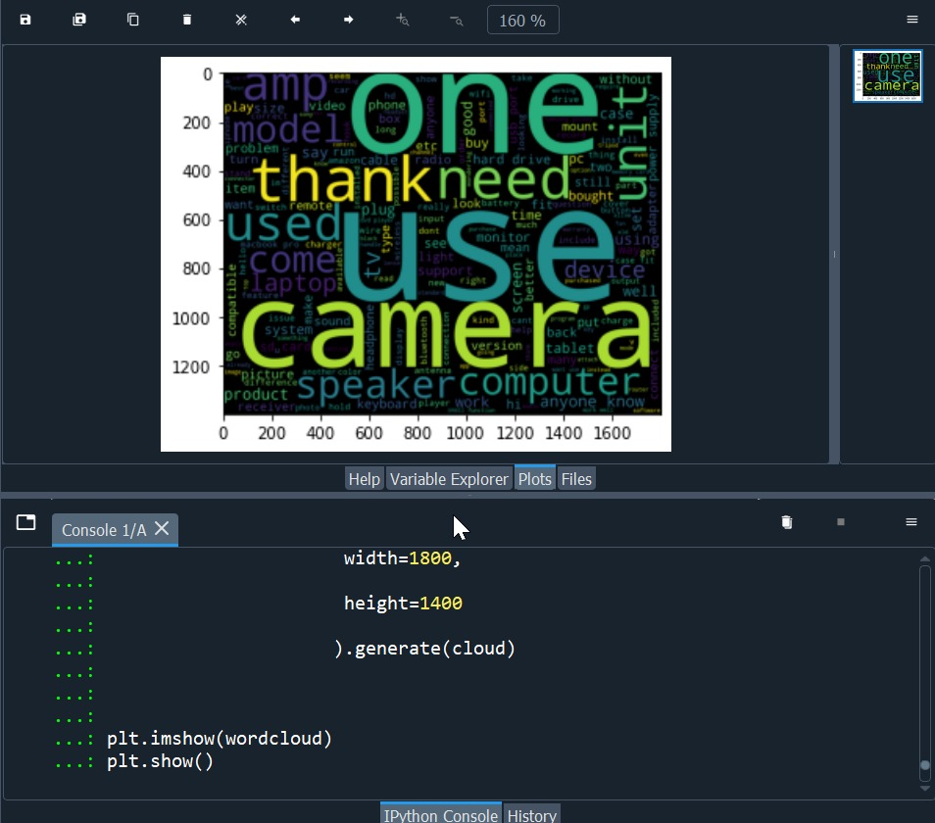
Methodology

Slide 5
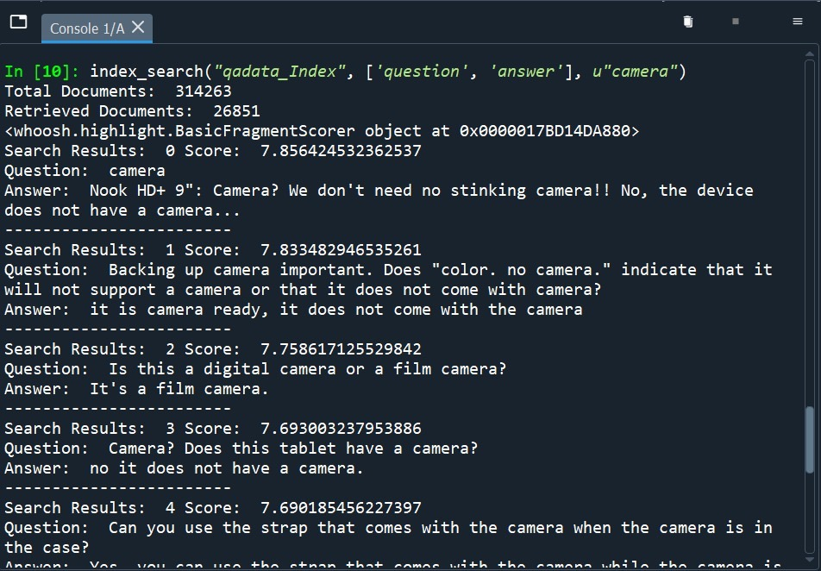
Features

Slide 6
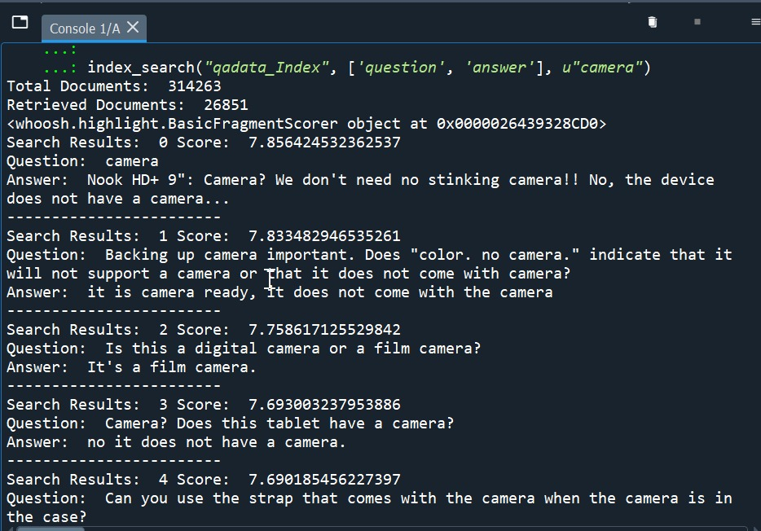
Tools

Slide 7
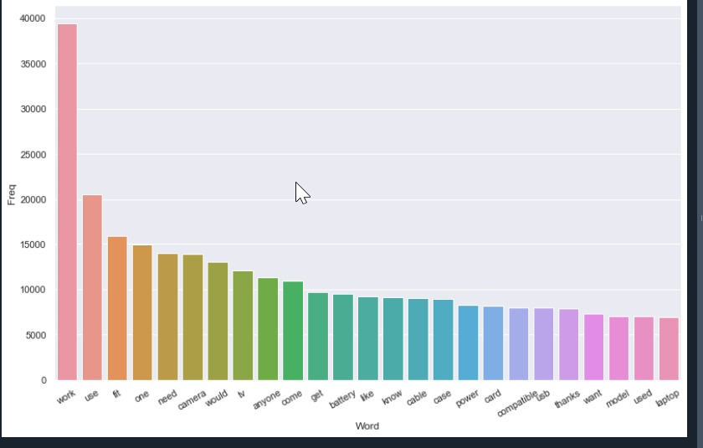
Unigram

Slide 8
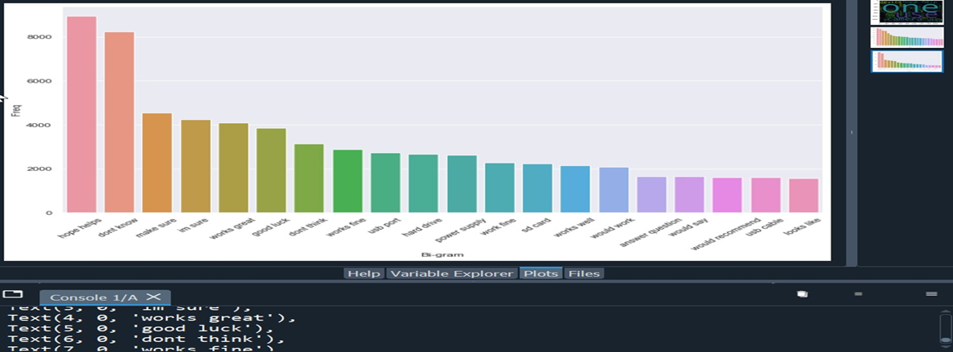
Bigram

Slide 9
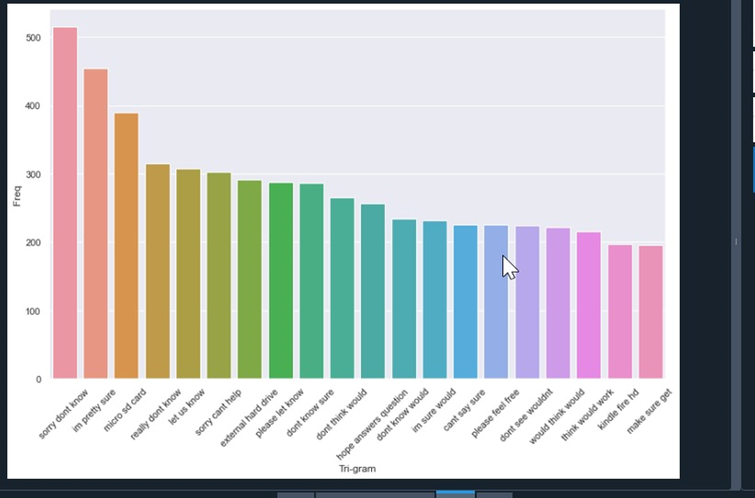
Trigram

Slide 10
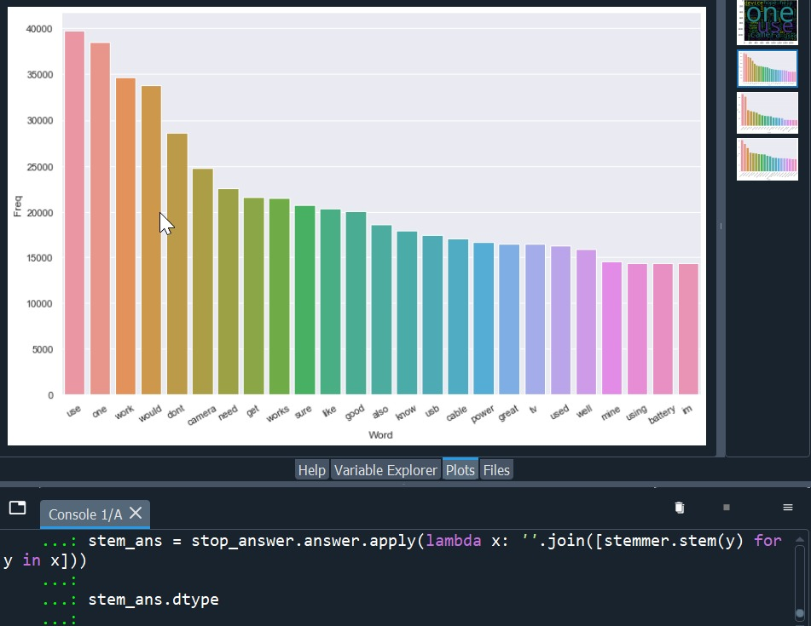
Visualization Results Unigram:

Slide 11
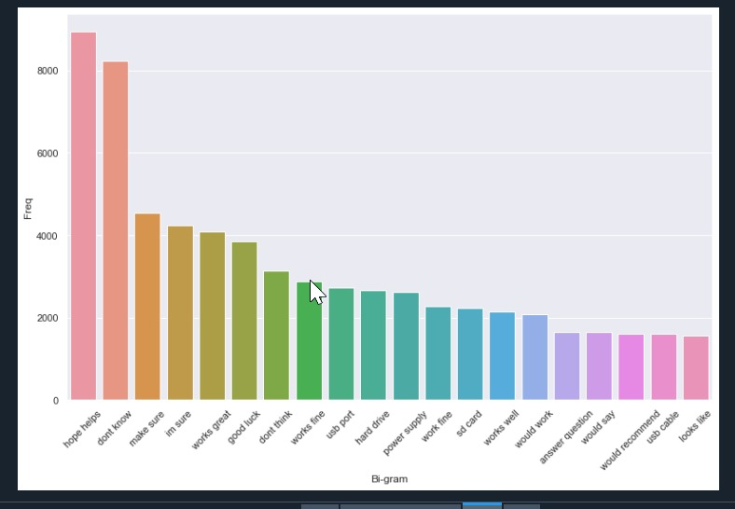
Bigram:

Slide 12

Trigram:

Slide 13


